Slide 1



Spring Security bcrypt Password Variants
m

Slide 2


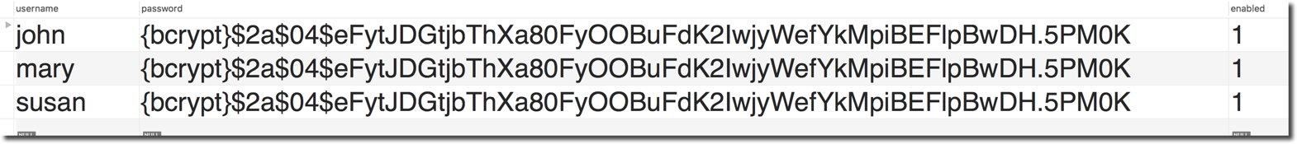
Spring Security Password Storage
There are different algorithms/variants for bcrypt passwords:
Passwords starting with: $2a$, $2b$, $2y$, …
Spring Security 5 only supports bcrypt passwords starting with $2a$
www.luv2code.com

Slide 3





Spring Security Password Storage
•
Currently, Spring Security 5 only supports bcrypt passwords starting with $2a$
Be sure to use $2a$
•
If you use a different variant starting with $2b$, $2y$, …
•
The login will FAIL and you will get this dreaded error message in server logs
WARNING: Encoded password does not look like BCrypt
Common pitfall
www.luv2code.com

Slide 4
BCrypt Variants
•
FAQ: What are all of the bcrypt variants?
•
Here is a good discussion of the BCrypt variants: $2a$, $2b$, $2y$, …
www.luv2code.com/bcrypt-variants
www.luv2code.com

Slide 5
Spring Security Custom Tables
m

Slide 6

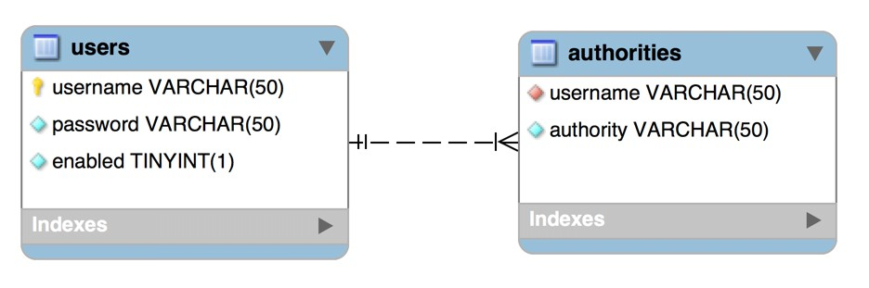
Default Spring Security Database Schema
www.luv2code.com

Slide 7
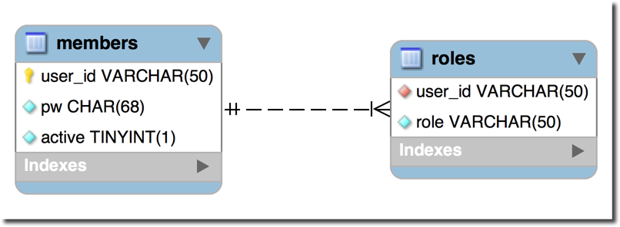
Custom Tables
What if we have our own custom tables?
Our own custom column names?
www.luv2code.com

Slide 8
For Security Schema Customization
•
Tell Spring how to query your custom tables
•
Provide query to find user by user name
•
Provide query to find authorities / roles by user name
www.luv2code.com

Slide 9
Development Process
Step-By-Step
Create our custom tables with SQL
Update JDBC properties file to point to new database schema
Update Spring Security Configuration
Provide query to find user by user name
Provide query to find authorities / roles by user name
www.luv2code.com

Slide 10
Step 1: Create our custom tables with SQL
www.luv2code.com

Slide 11


Step 2: Update JDBC properties file to point to new database schema
File: src/main/resources/persistence-mysql.properties
#
# JDBC connection properties #
jdbc.driver=com.mysql.jdbc.Driver jdbc.url=jdbc:mysql://localhost:3306/spring_security_demo_bcrypt_custom?useSSL=false jdbc.user=springstudent
jdbc.password=springstudent
#
# Connection pool properties #
connection.pool.initialPoolSize=5 connection.pool.minPoolSize=5 connection.pool.maxPoolSize=20 connection.pool.maxIdleTime=3000
www.luv2code.com

Slide 12

Step 3: Update Spring Security Configuration
@Configuration @EnableWebSecurity
public class DemoSecurityConfig extends WebSecurityConfigurerAdapter {
@Autowired
private DataSource securityDataSource;
@Override
protected void configure(AuthenticationManagerBuilder auth) throws Exception {
auth.jdbcAuthentication().dataSource(securityDataSource)
.usersByUsernameQuery("select user_id, pw, active from members where user_id=?")
.authoritiesByUsernameQuery("select user_id, role from roles where user_id=?");
}
…
}
www.luv2code.com

Slide 13





Step 3: Update Spring Security Configuration
@Configuration @EnableWebSecurity
public class DemoSecurityConfig extends WebSecurityConfigurerAdapter {
@Autowired
private DataSource securityDataSource;
@Override
protected void configure(AuthenticationManagerBuilder auth) throws Exception {
How to find users
auth.jdbcAuthentication().dataSource(securityDataSource)
.usersByUsernameQuery("select user_id, pw, active from members where user_id=?")
.authoritiesByUsernameQuery("select user_id, role from roles where user_id=?");
}
…
Question mark “?” Parameter value will be the
}
user name from login form
www.luv2code.com

Slide 14





Step 3: Update Spring Security Configuration
@Configuration @EnableWebSecurity
public class DemoSecurityConfig extends WebSecurityConfigurerAdapter {
@Autowired
private DataSource securityDataSource;
@Override
protected void configure(AuthenticationManagerBuilder auth) throws Exception {
auth.jdbcAuthentication().dataSource(securityDataSource)
.usersByUsernameQuery("select user_id, pw, active from members where user_id=?")
.authoritiesByUsernameQuery("select user_id, role from roles where user_id=?");
How to find roles
}
…
Question mark “?” Parameter value will be the
}
user name from login form
www.luv2code.com

